Slide 1
Variational inference intro slides CNNs, fingerprinting, VAEs

Slide 2
Use case 1: Finding fingerprints in datasets with unsupervised learning

Slide 3
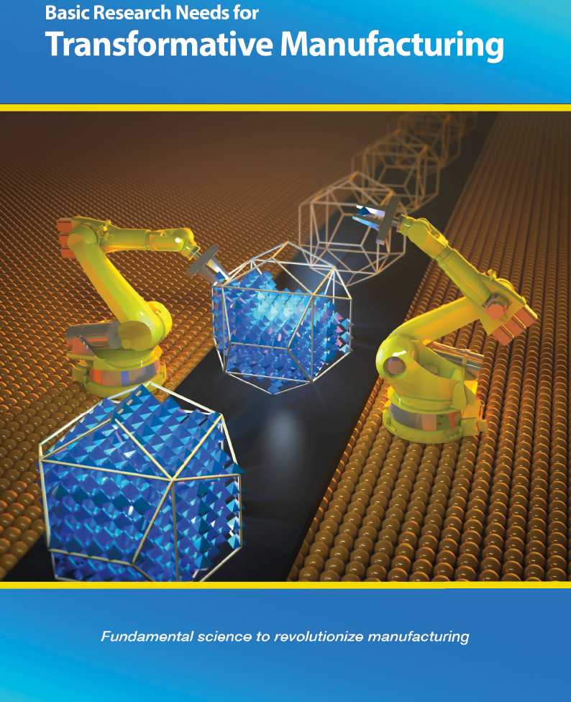
Intro to fingerprinting in material datasets

Slide 4
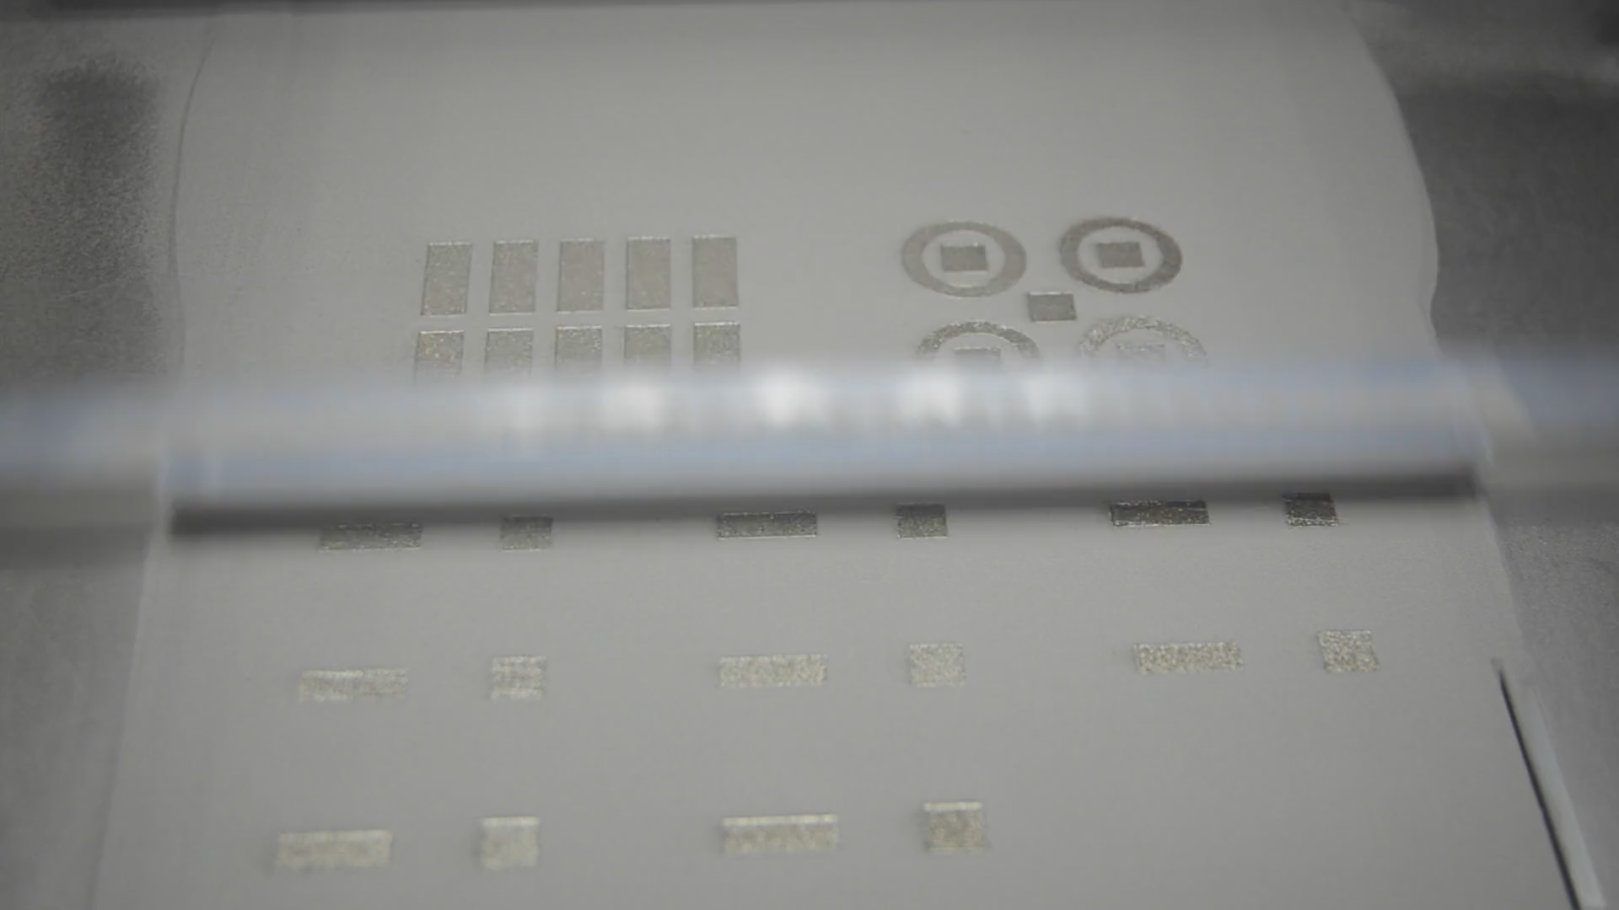
2. Multimodality in advanced manufacturing processes Multimodality: heterogeneous data Process parameters: laser, powder, speed High-fidelity characterization: microscopy, XRF, XRD, TEM, SEM Low-fidelity signals: light, sound, images, profilometry

Slide 5
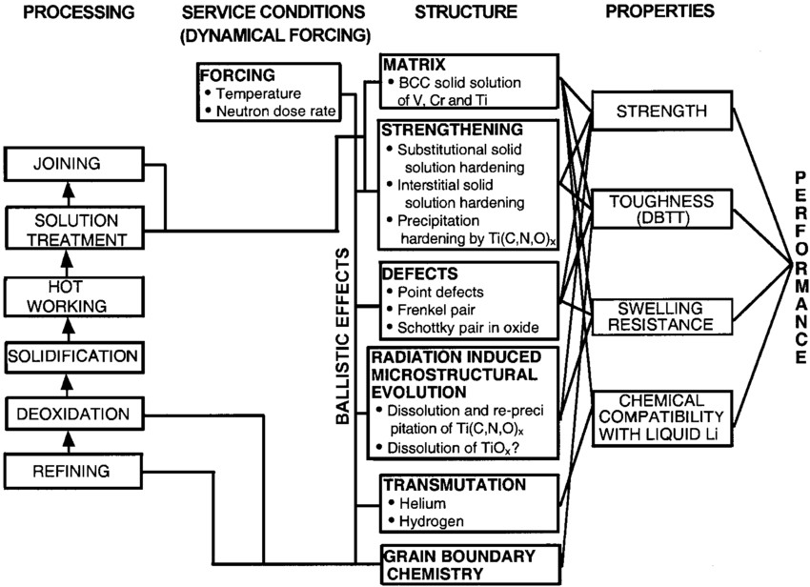
3. Moving beyond ”black box ML”
When people say AI (as opposed to ML) often they envision modular reasoning and cause/effect
(e.g. Olson Diagram)
Ghosh. Journal of Phase Equilibria. 2002

Slide 6
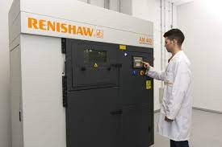
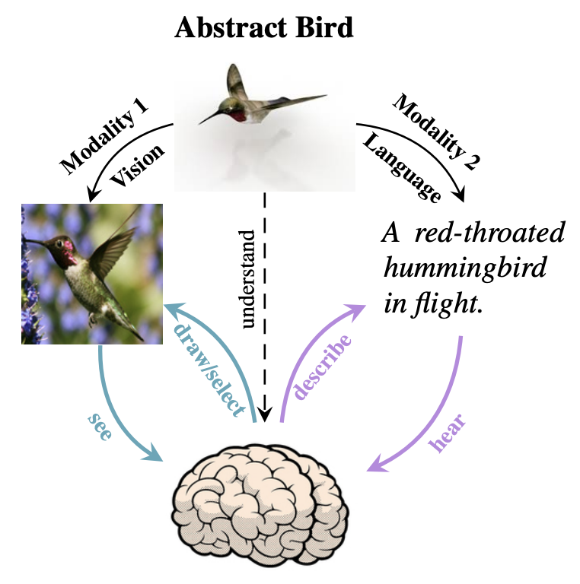
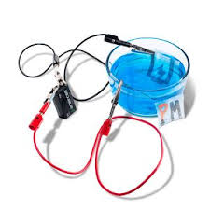
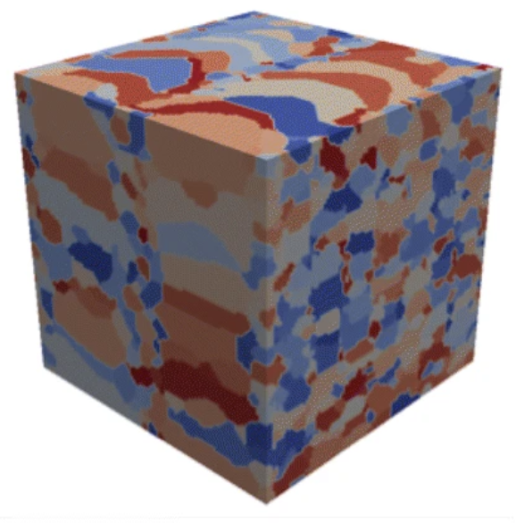
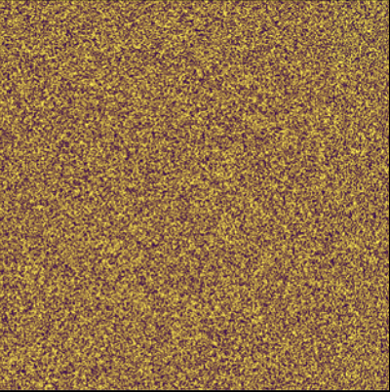

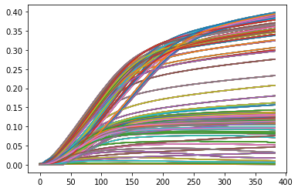

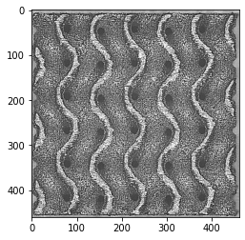
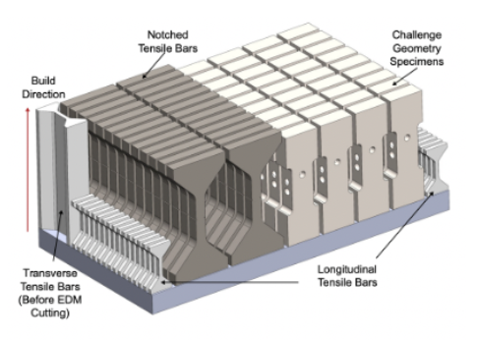
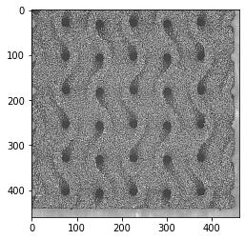
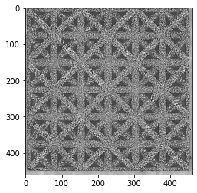
What do we mean by multimodal deep learning?
Traditional Multimodality
Assimilate heterogeneous data sources so they’re greater than sum of their parts
e.g. audio + text to generate
automatic subtitles
High-Fidelity Modalities
Classical material characterization
e.g. microscopy (physical), direct simulation (synthetic)
High-Throughput Modalities Unconventional measurements
e.g. spectroscopy, electrical signals, sound, photographs
AI4SS + AI@DOE workshops denote multimodal scientific data a top opportunity for scientific impact across DOE in next 5-10 years
Shi, Y., Siddharth, N., Paige, B. and Torr, P.H., 2019. Variational mixture-of-experts autoencoders for multi-modal deep generative models. arXiv preprint arXiv:1911.03393.

Slide 7
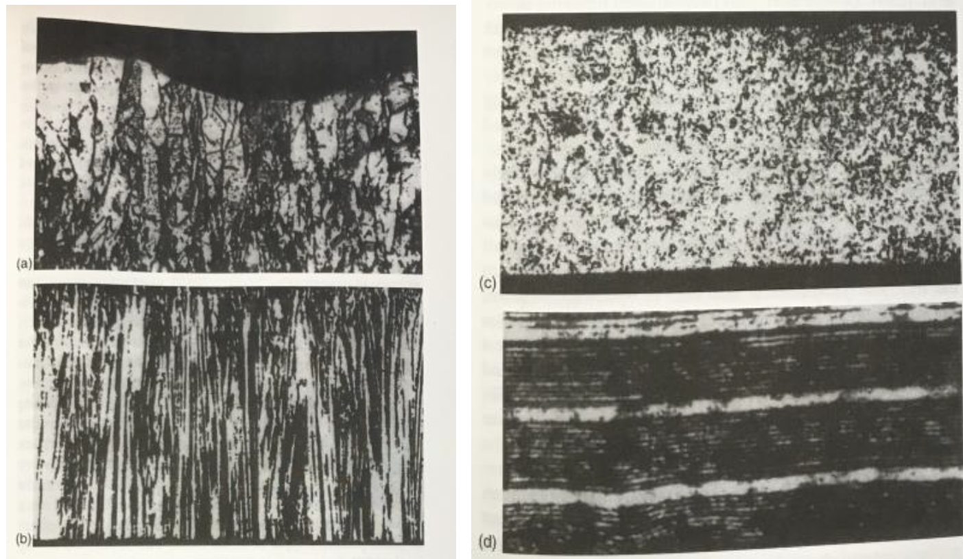
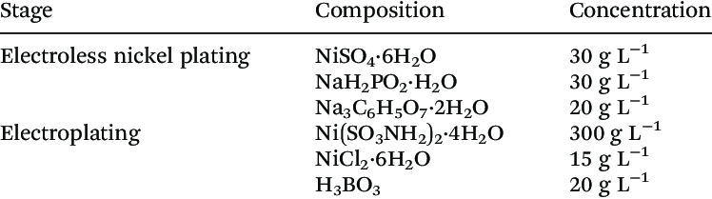
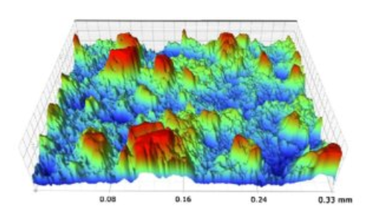
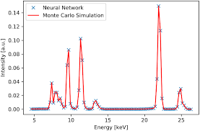
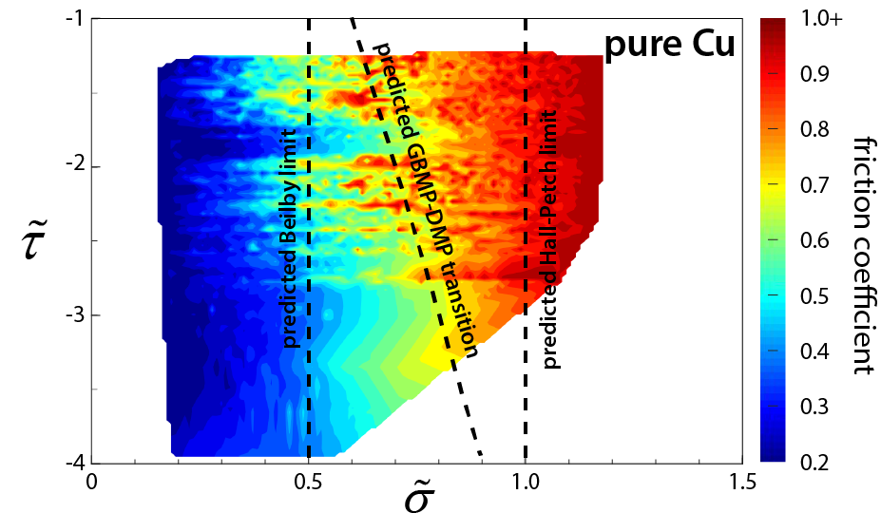
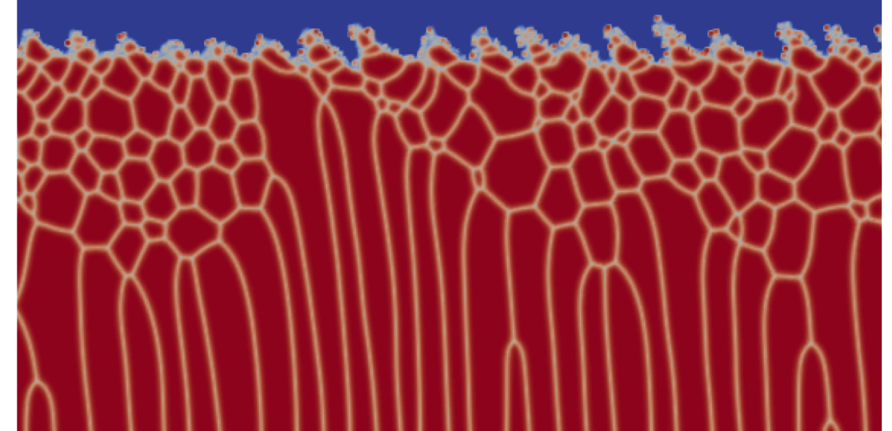
Pre-process In-process Post-process
Process settings
Microscopy & Characterization
Time-series data
Precursor characterization
High-fidelity mod/sim
In-situ characterization
Property/Performance/Aging Measurements
Sifting through a quantity of modalities beyond limits of human cognition

Slide 8
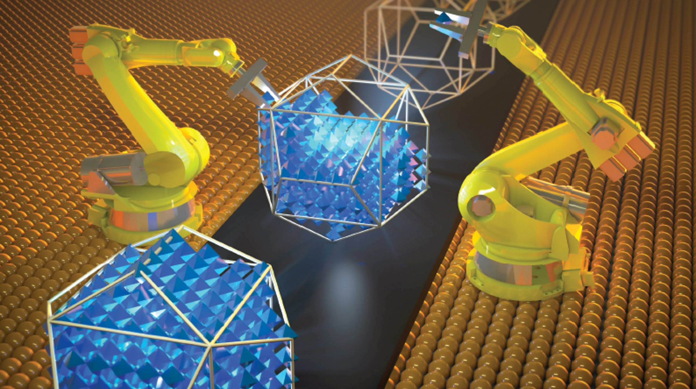
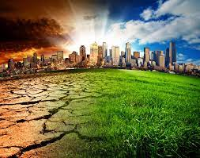

Hunting for fingerprints
Fingerprint: low dimensional signal correlating with an underlying complex physical process
State-of-the-Art: PCA, feature engineering
Idea: use unsupervised learning to find exploitable fingerprints in multimodal data?
Chakraborty, A., Nandi, P., and Chakraborty, B. Fingerprints of the quantum space-time in time-dependent quantum mechanics: An emergent geometric phase. arXiv preprint arXiv:2110.04370, 2021.
Hasselmann, K. Multi-pattern fingerprint method for detection and attribution of climate change. Climate dynamics, 13(9):601–611, 1997.

Slide 9
Use case 2: Identifying latent dynamics in high dimensional data

Slide 10
Some slides on VAEs

Slide 11
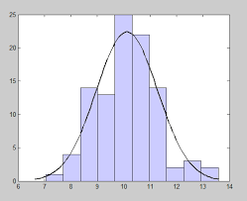
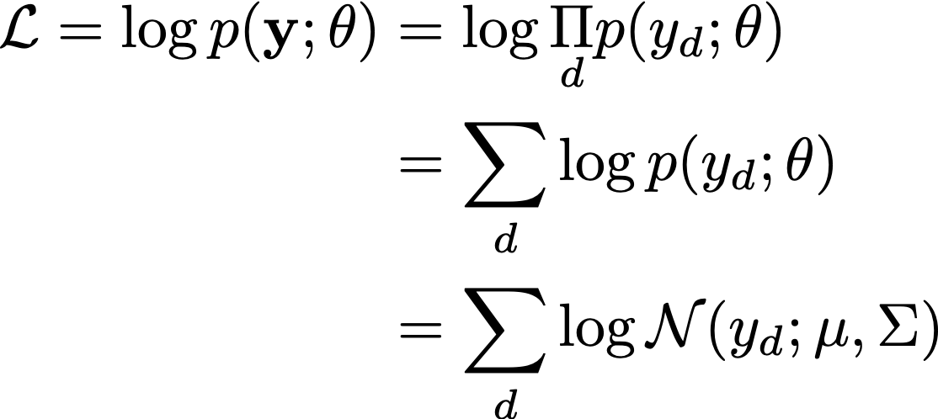
Maximum likelihood estimation 101
Given data, how do you fit a distribution to it?

Slide 12
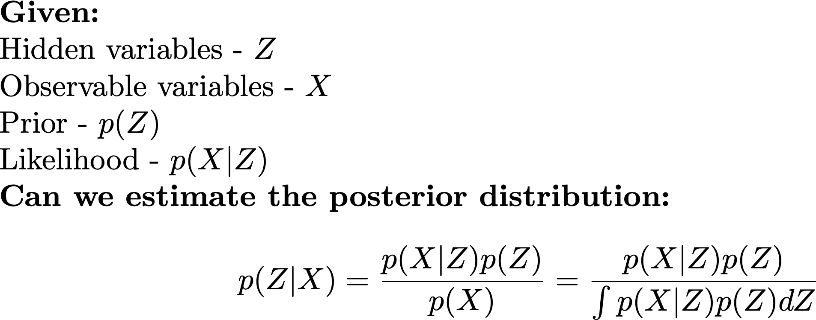
Variational inference 101 – handling hidden data
Computationally intractable integral
Two primary options:
Sampling (Monte Carlo, Metropolis Hastings) = expensive
Variational inference – optimization centric
Notes:
\noindent \textbf{Given:}\\
{Hidden variables - $Z$}\\
{Observable variables - $X$}\\
{Prior - $p(Z)$}\\
{Likelihood - $p(X|Z)$}\\
\noindent\textbf{Can we estimate the posterior distribution:}
$$p(Z|X) = \frac{p(X|Z) p(Z)}{p(X)} = \frac{p(X|Z) p(Z)}{\int p(X|Z) p(Z) dZ}$$

Slide 13
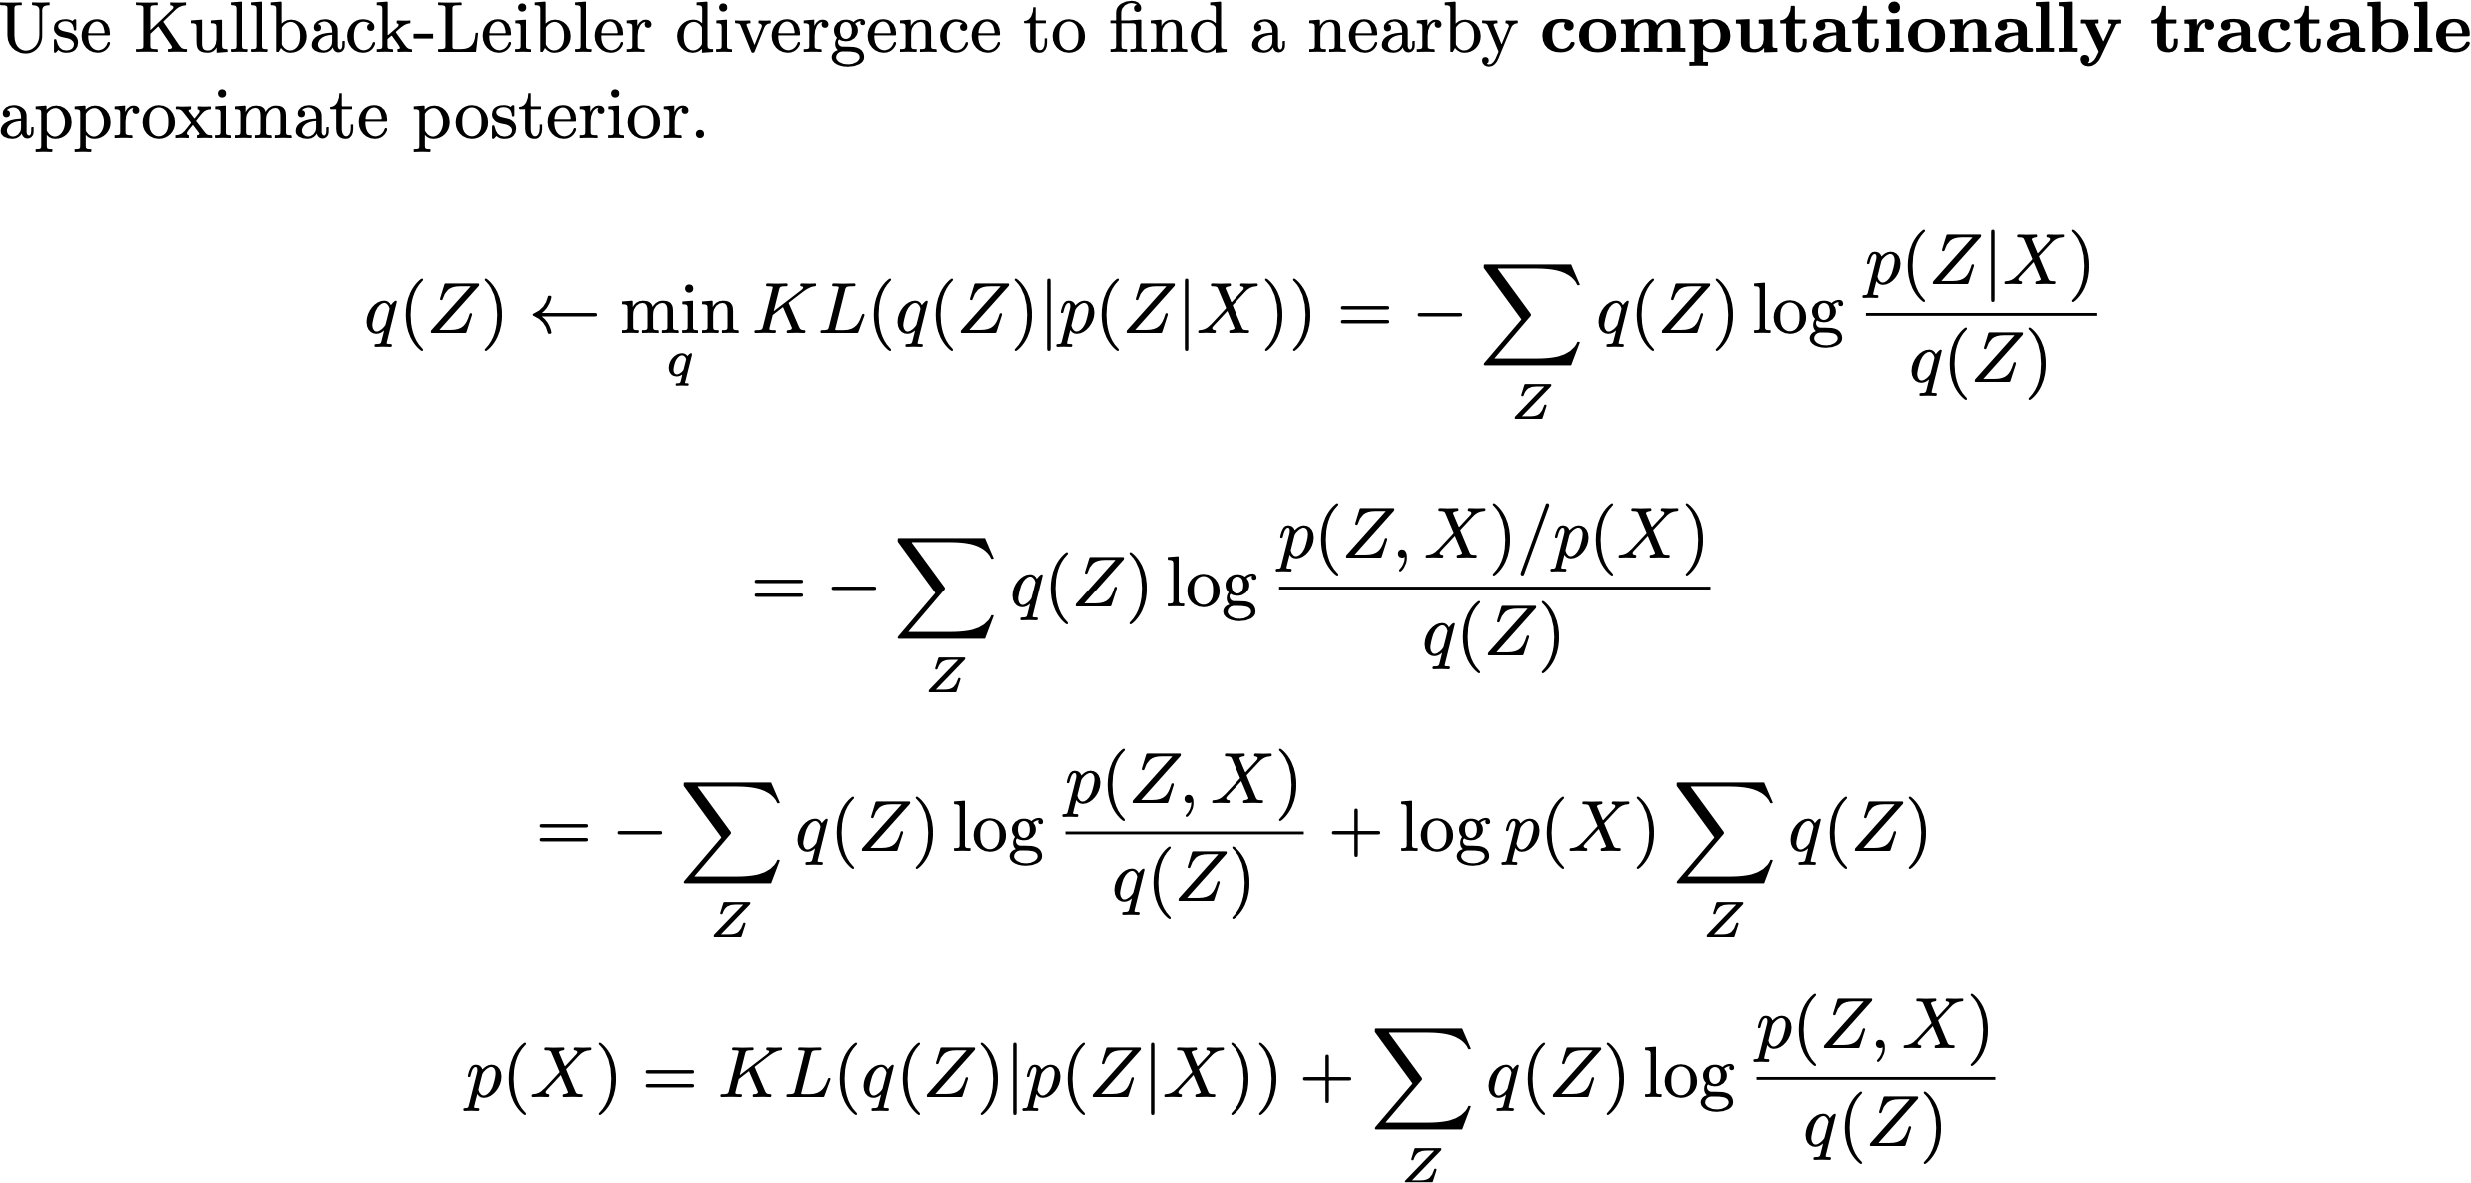
Variational inference 101
Evidence-based lower bound (ELBO)
Minimizing the first term is equivalent to maximizing the ELBO
Have data for ELBO but not KL term, so max ELBO instead
Notes:
\noindent Use Kullback-Leibler divergence to find a nearby $\textbf{computationally tractable}$ approximate posterior.
$$q(Z) \leftarrow \underset{q}{\text{min}}\, KL( q(Z) | p(Z|X) ) = - \sum_{Z} q(Z) \log \frac{p(Z|X)}{q(Z)}$$
$$ = - \sum_{Z} q(Z) \log \frac{p(Z,X)/p(X)}{q(Z)} $$
$$ = - \sum_{Z} q(Z) \log \frac{p(Z,X)}{q(Z)} + \log p(X) \sum_Z q(Z)$$
$$ p(X) = KL( q(Z) | p(Z|X) ) + \sum_{Z} q(Z) \log \frac{p(Z,X)}{q(Z)}$$

Slide 14
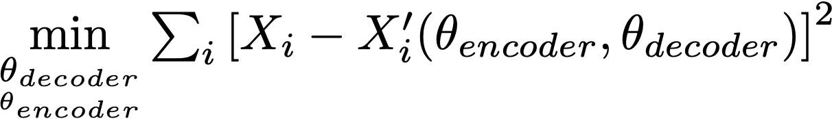
Dimensionality reduction: vanilla autoencoders
X
Encoder
Decoder
X’
Z
Learning identity map with bottleneck gives nonlinear dimensionality reduction as simple regression problem.
x
z
Latent Space

Slide 15
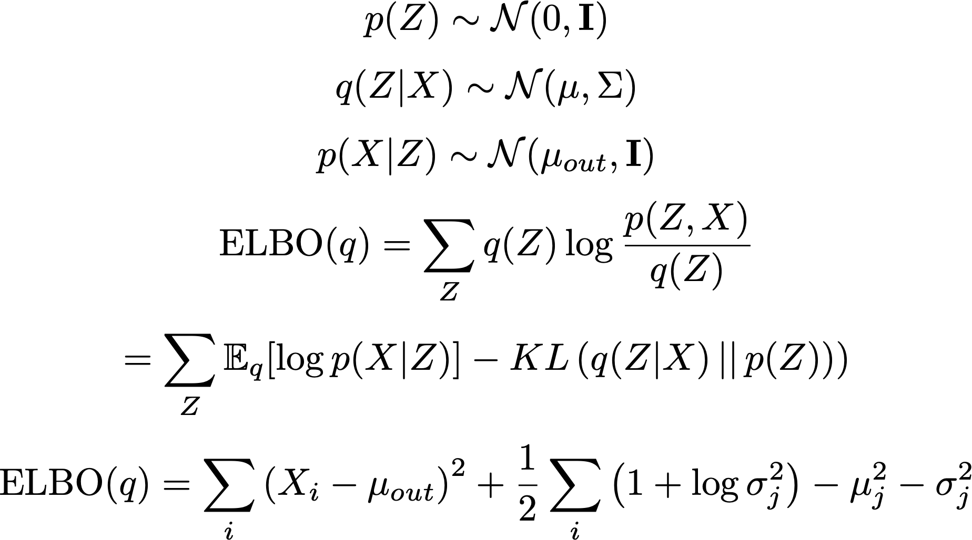
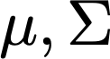
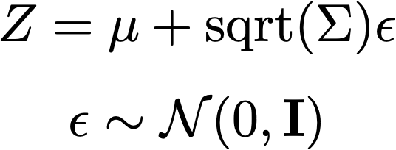
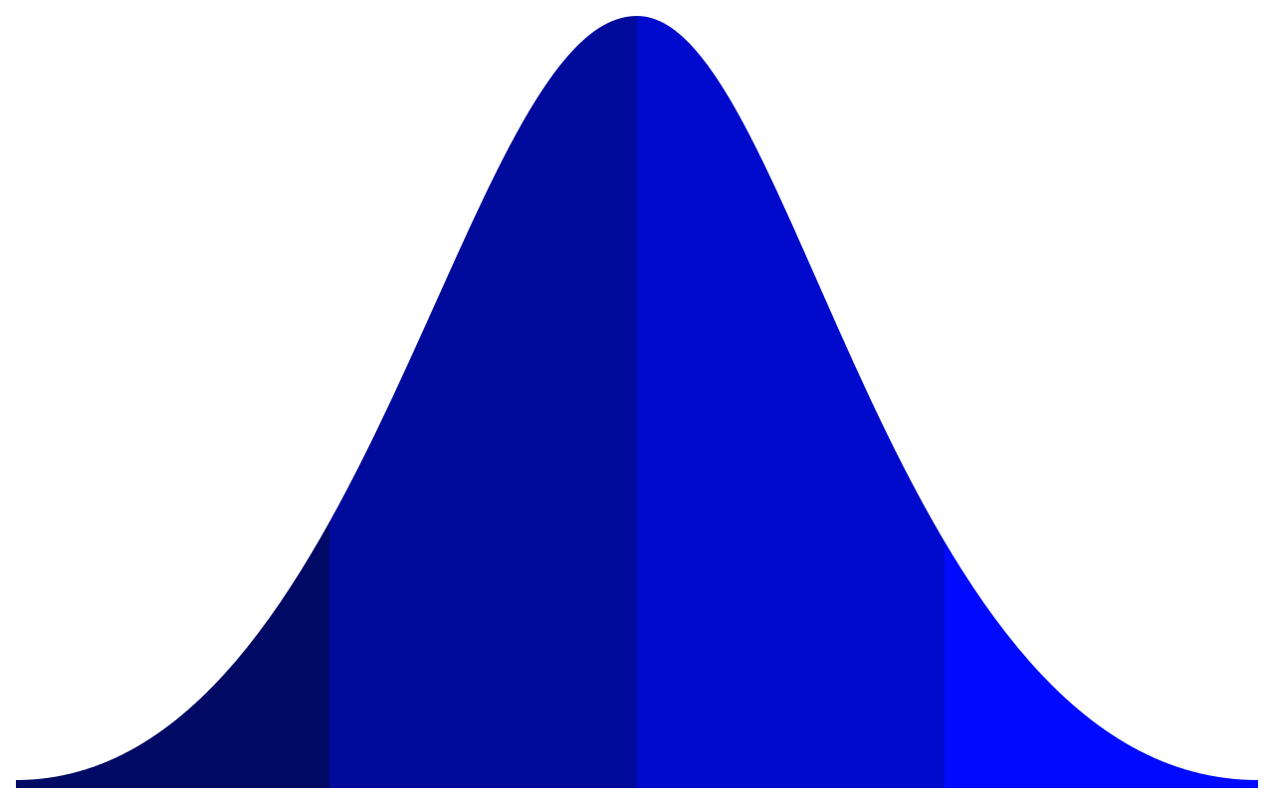
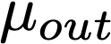
Dimensionality reduction: variational autoencoders
X
Z
Reconstruction Error
(MSE)
Prior/Posterior Mismatch Penalty
x
z
Latent Space
Notes:
$\text{ELBO}(q) = \sum_{Z} q(Z) \log \frac{p(Z,X)}{q(Z)}$
$$Z = \mu + \text{sqrt}(\Sigma) \epsilon$$
$$\epsilon \sim \mathcal{N}(0,\mathbf{I})$$
$$p(Z) \sim \mathcal{N}(0,\mathbf{I})$$
$$q(Z|X) \sim \mathcal{N}(\mu,\Sigma)$$
$$p(X|Z) \sim \mathcal{N}(\mu_{out},\mathbf{I})$$
$$\text{ELBO}(q) = \sum_{Z} q(Z) \log \frac{p(Z,X)}{q(Z)}$$
$$ = \sum_{Z} \mathbb{E}_q[\log p(X|Z)] - KL\left(q(Z|X)\,||\, p(Z))\right)$$
$$\text{ELBO}(q) = \sum_i \left( X_i - \mu_{out} \right)^2 + \frac12 \sum_i \left(1 + \log \sigma_j^2\right) - \mu_j^2 - \sigma_j^2$$

Slide 16
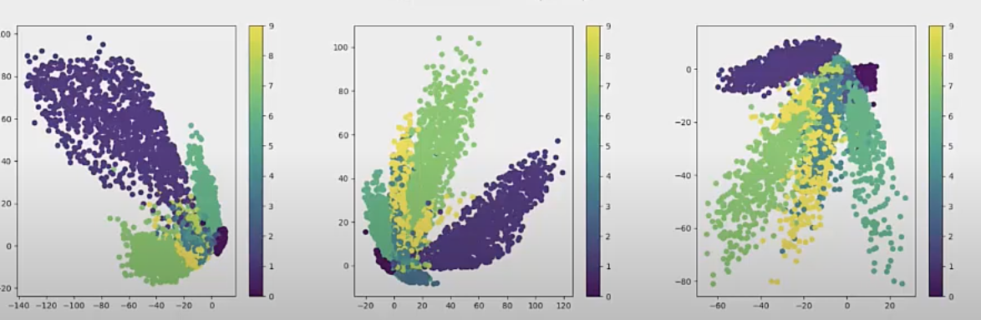
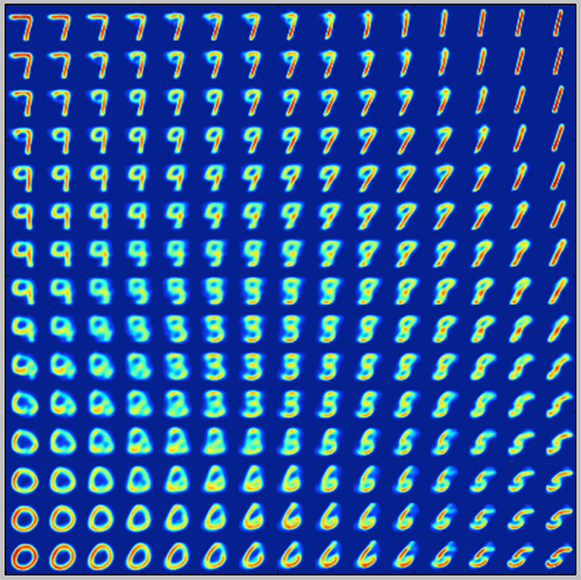
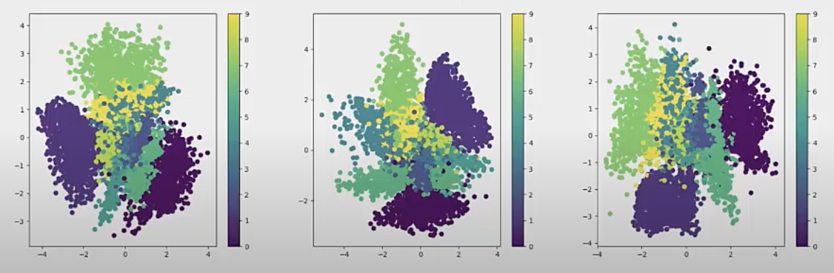
Steering embedding in latent space
VAE Vanilla AE
Ex: Embedding handwritten digits 0-9
Prior keeps support of embedding on unit ball
Sampling from Z allows generative modeling
https://www.youtube.com/watch?v=itOlzH9FHkI
https://blog.keras.io/building-autoencoders-in-keras.html

Slide 17
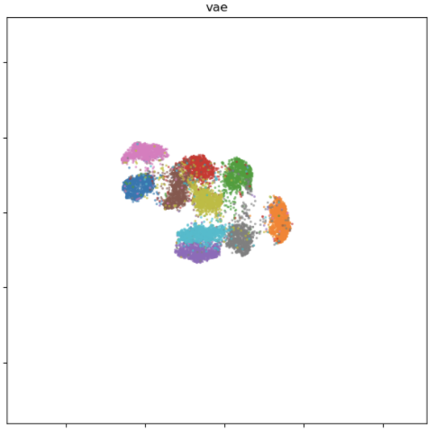
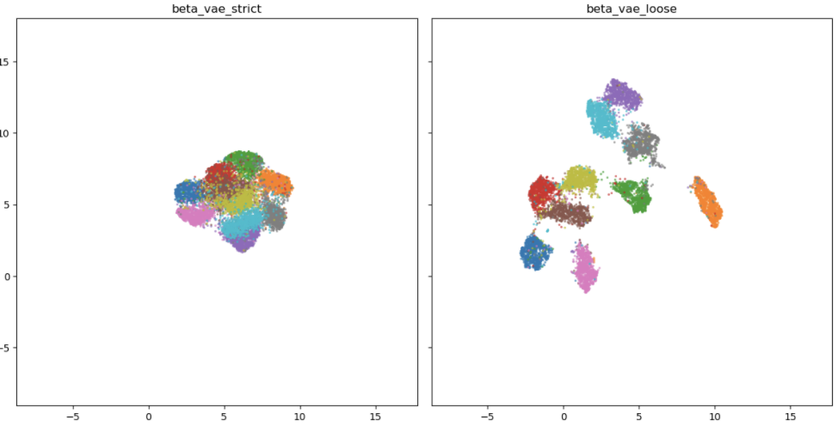
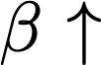
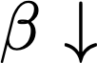
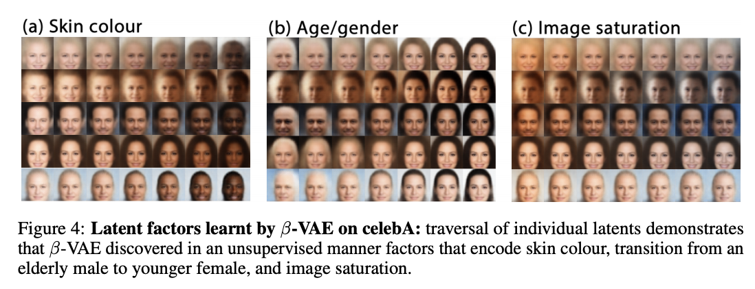
Obtaining disentangled latent representations
Higgins, I., Matthey, L., Pal, A., Burgess, C., Glorot, X., Botvinick, M., Mohamed, S. and Lerchner, A., 2016. beta-vae: Learning basic visual concepts with a constrained variational framework.
https://krokotsch.eu/autoencoders/2021/01/24/Autoencoder_Bake_Off.html

Slide 18
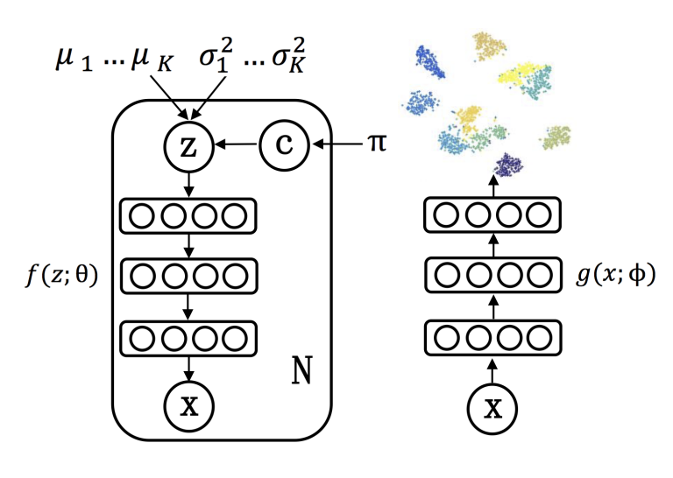
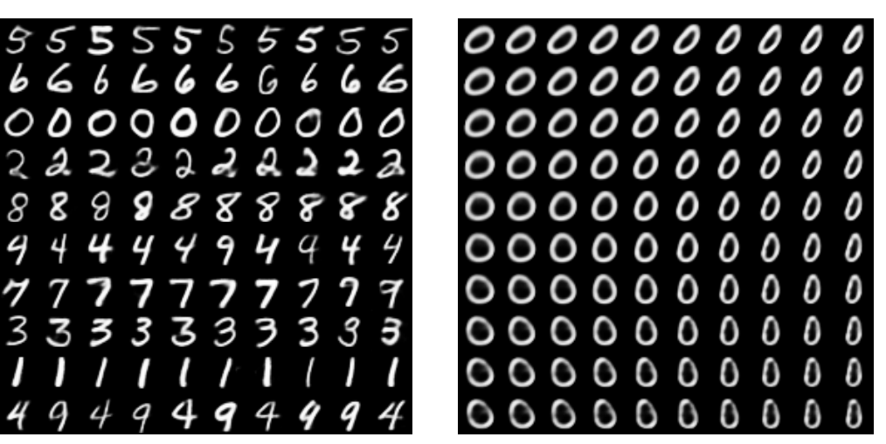
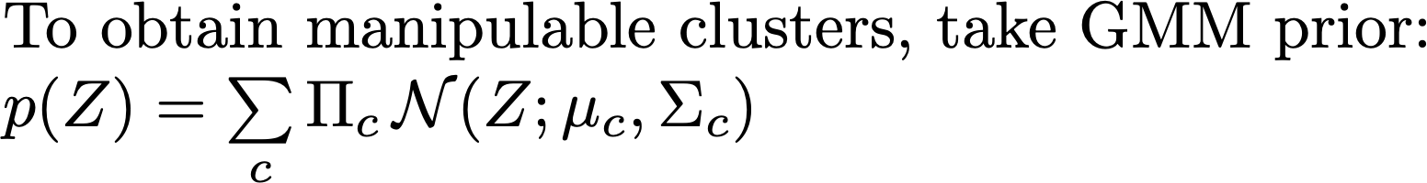
Disentangled representations for unsupervised learning
Jiang, Zhuxi, et al. "Variational deep embedding: An unsupervised and generative approach to clustering." arXiv preprint arXiv:1611.05148 (2016).
Dilokthanakul, Nat, et al. "Deep unsupervised clustering with gaussian mixture variational autoencoders." arXiv preprint arXiv:1611.02648 (2016).

Slide 19
1 slide on CNNs

Slide 20
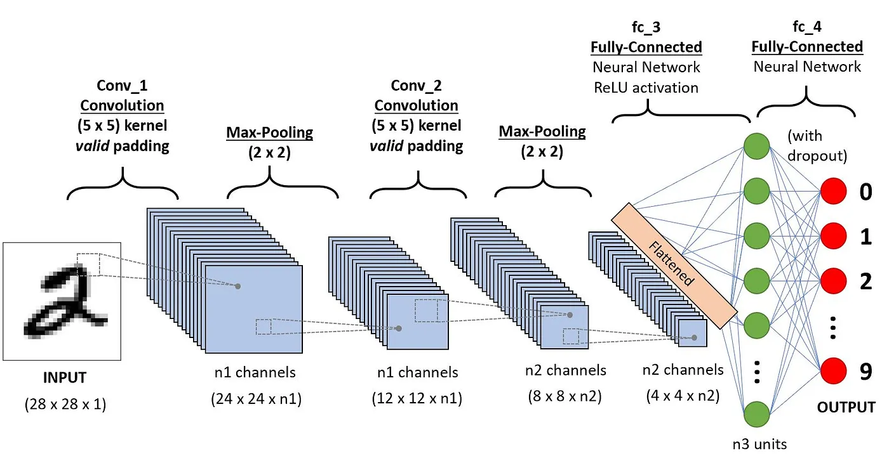
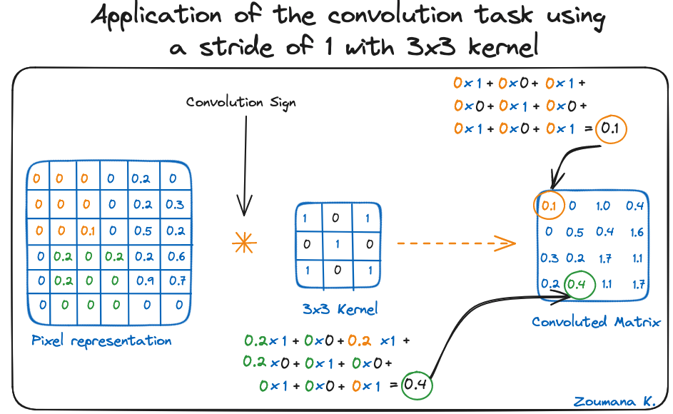
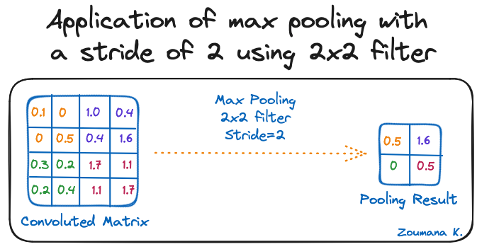
https://www.datacamp.com/tutorial/introduction-to-convolutional-neural-networks-cnns

Slide 21
Implementation of VAE

